Slide 1

SHEILA MURUGI MUNYIRI E033-01-1366/2020
BED CIVIL ENGINEERING
CAPSTONE PROJECT 1

Slide 2
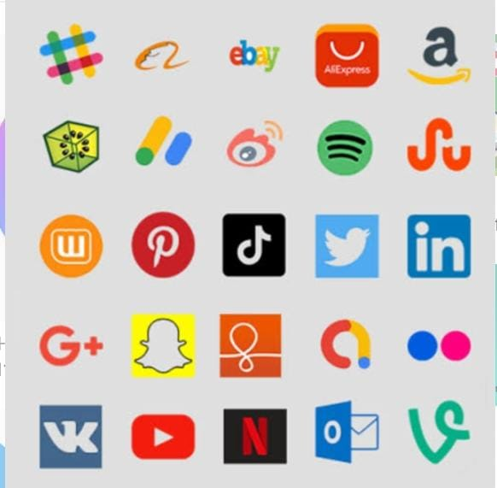

In today's interconnected world, social media has emerged as a powerful force shaping how we communicate, consume information, and interact with the world around us. From connecting with friends and family to accessing news and entertainment, social media platforms have become integral parts of our daily lives. However, with this unprecedented level of connectivity comes a myriad of opportunities and challenges that individuals, businesses, and society at large must navigate.

Slide 3
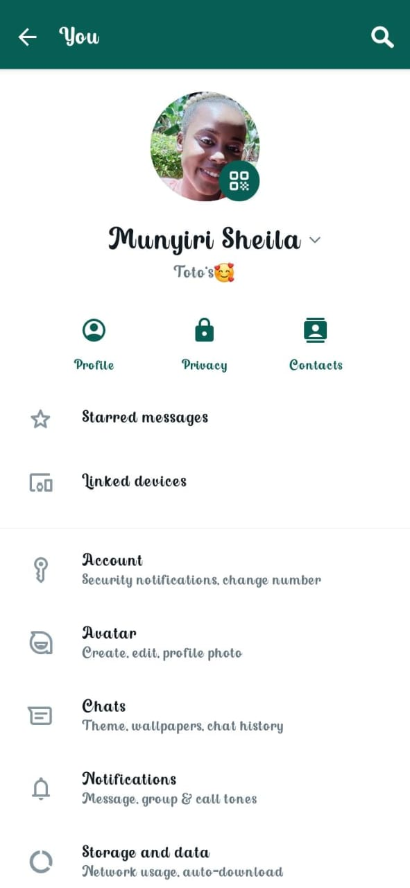


Slide 4

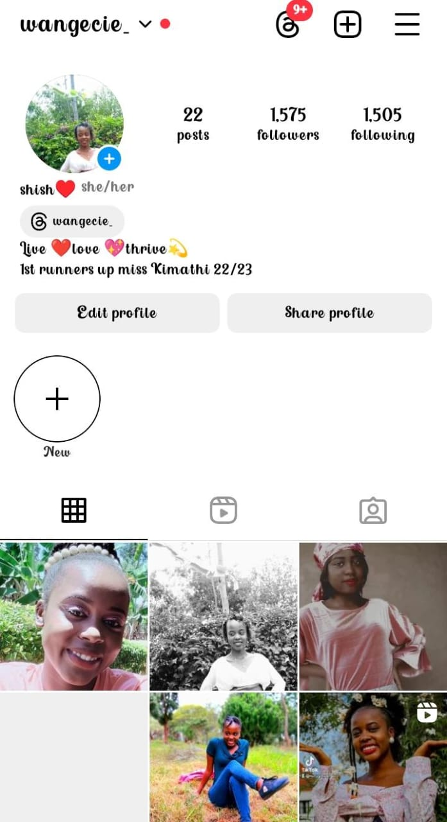

Slide 5
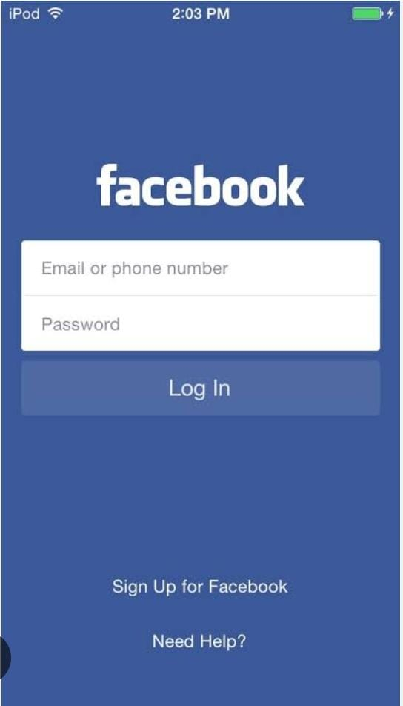
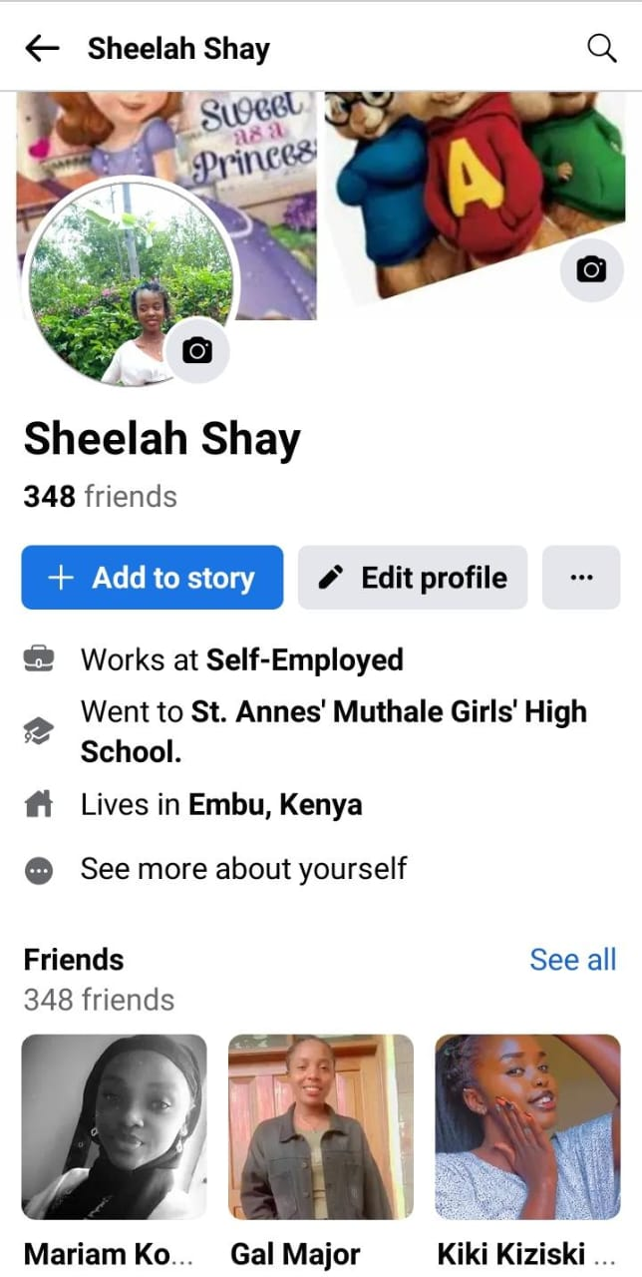

Slide 6
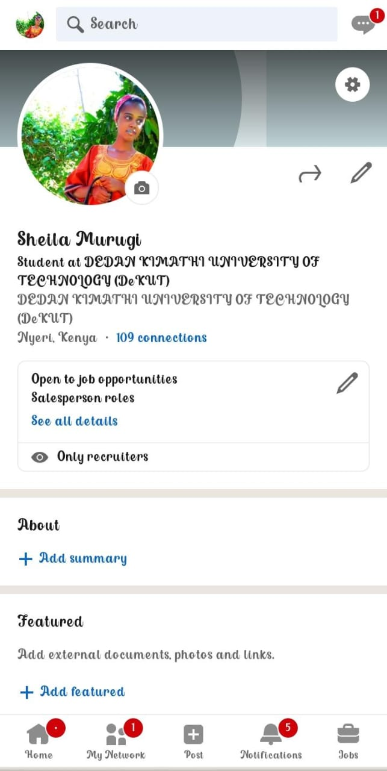
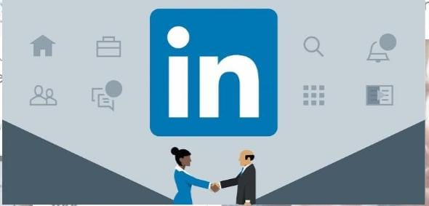

Slide 7
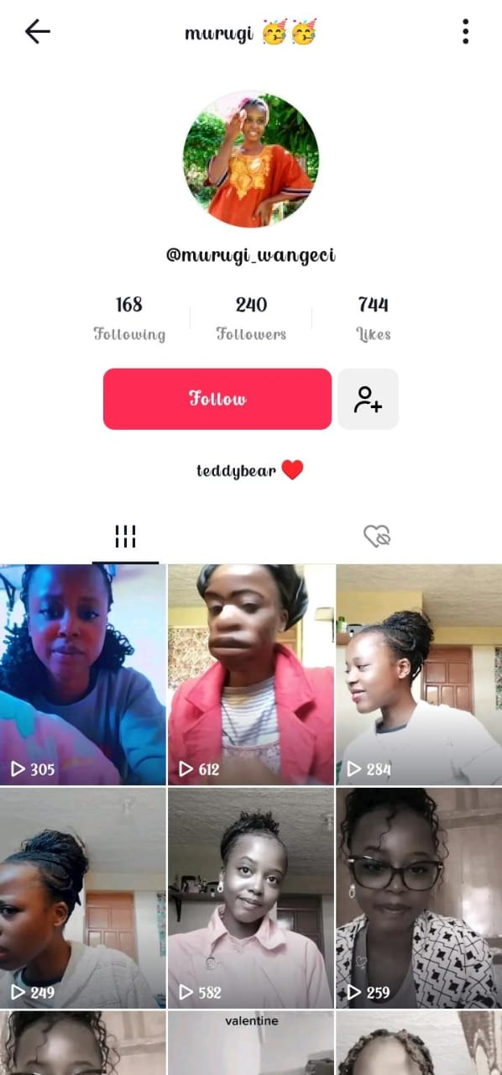


Slide 8
CONCLUSION
in today's highly competitive digital landscape, having a presence on social media is not just advantageous—it's essential for staying relevant and competitive. Whether you're an individual looking to expand your network, a business aiming to reach new customers, or an organization seeking to amplify your message, embracing social media can open up a world of opportunities.

